Slide 1

Annotation Tool Development Update
siemens.ch
Restricted © Siemens Switzerland Ltd 2017

Slide 2

Annotation Tool Development Table of content
基础功能 3
文件I/O 4
关键点编辑 5
界面介绍 6
遇到的问题 8
待开发功能 12

Slide 3
基础功能

Slide 4
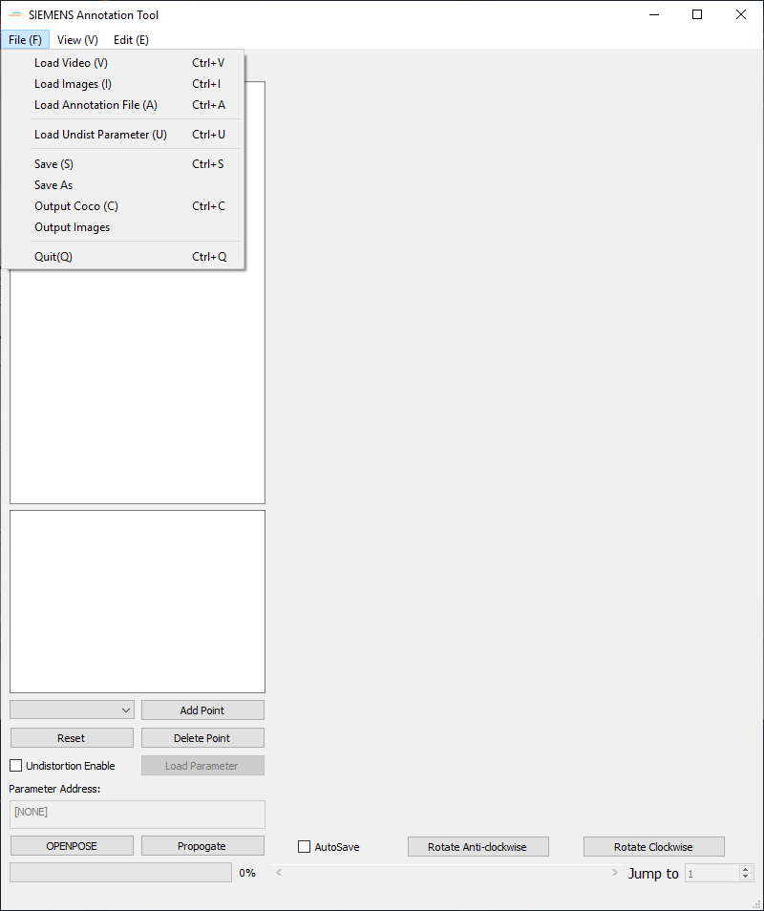
基础功能 File I/O
导入视频文件
导入图片集
直接读取*.annot 文件
加载图像校正参数文件(*.yml)
输出*.annot文件
输出COCO数据集json格式(未完成)
输出图片集(标注过程中处理过的)

Slide 5
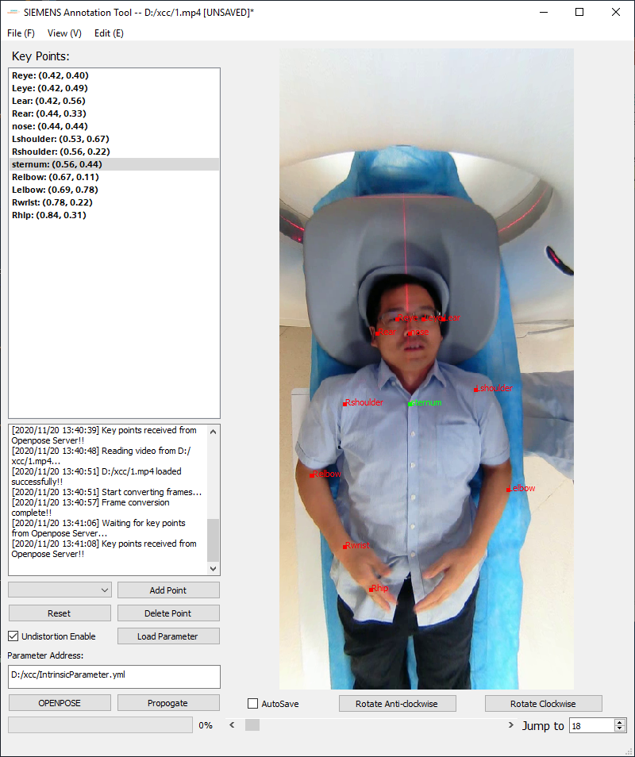
基础功能 关键点编辑
OPENPOSE预测关键点 (openpose部署在服务器上)
手动添加/删除/重置关键点
手动移动关键点

Slide 6
界面介绍

Slide 7

界面介绍
读取文件路径/保存状态
菜单栏
关键点列表
图像窗口
信息栏
自动保存开关
关键点编辑
矫正参数文件路径/开关
图像旋转
OPENPOSE
进度条
视频/图像集信息
页面控制

Slide 8
遇到的问题

Slide 9
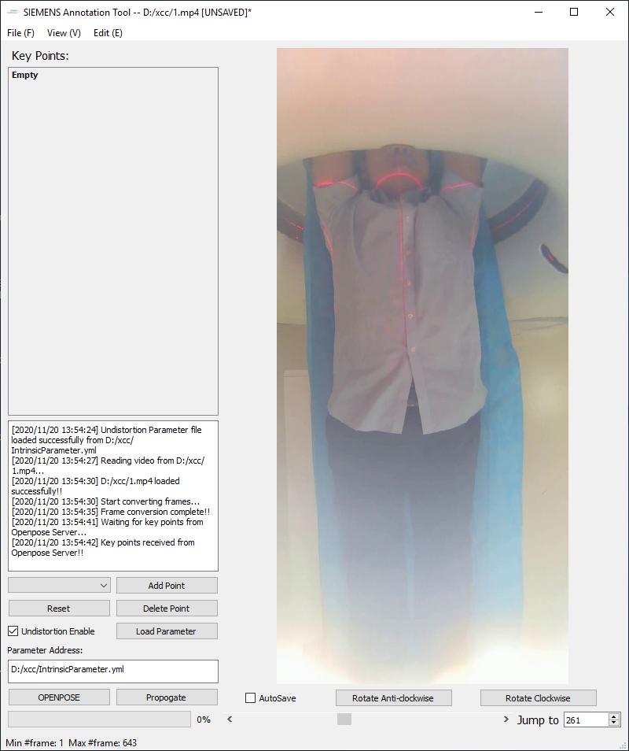
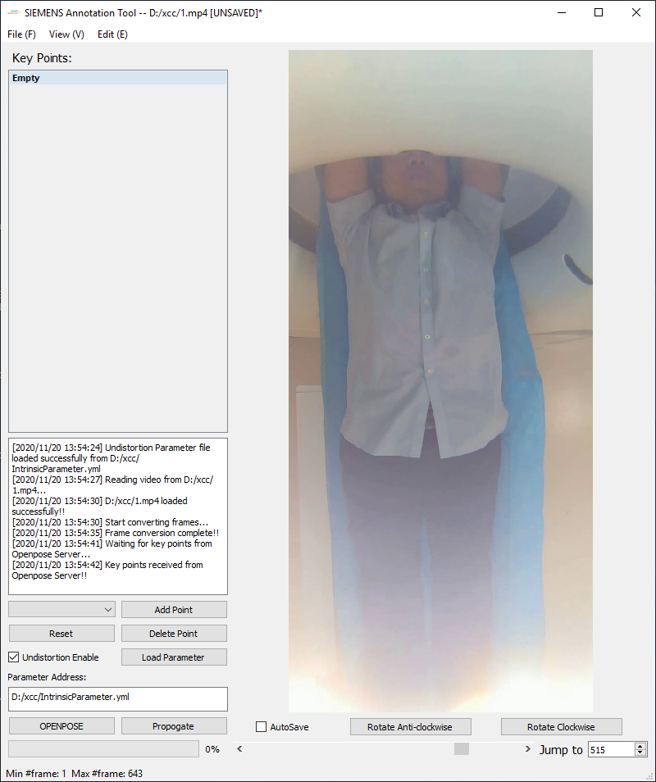
遇到的问题
过曝导致图像信息丢失

Slide 10
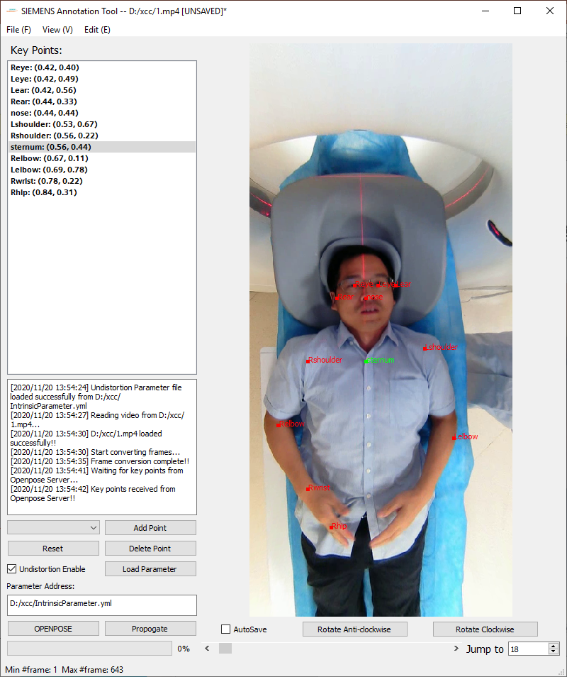
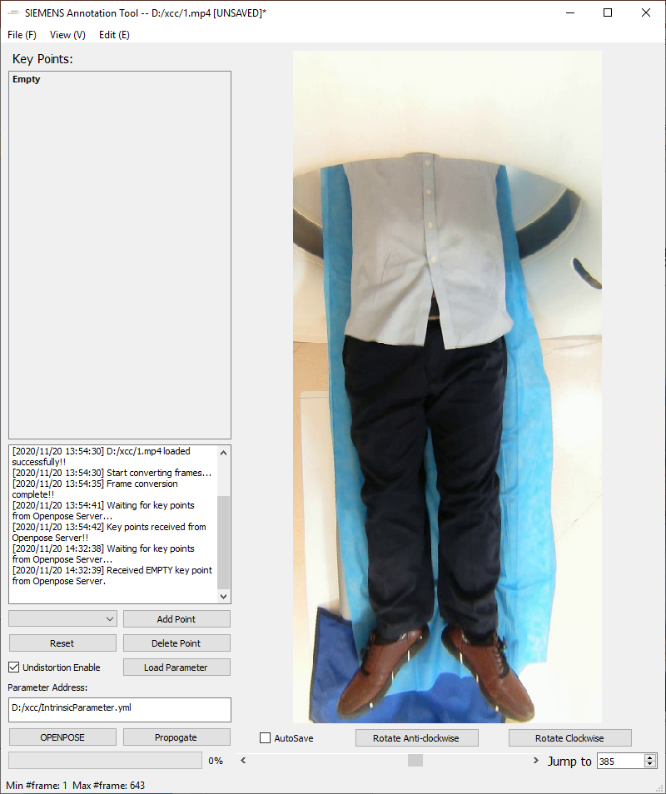
遇到的问题
难以一帧确定人体全部关键点

Slide 11
遇到的问题 OPENPOSE依赖头部定位
需要手动标点

Slide 12
待开发功能

Slide 13
待开发功能
以COCO格式输出json文件
光流法 (e.g. Recurrent All-Pairs Field Transforms, RAFT) 向前向后自动添加标注
拓展工具应用场景（矩形，圆形标注，更自由的I/O格式）
。
。
。

Slide 14
谢谢！

Slide 15
Annotation Tool Development Update

Slide 16
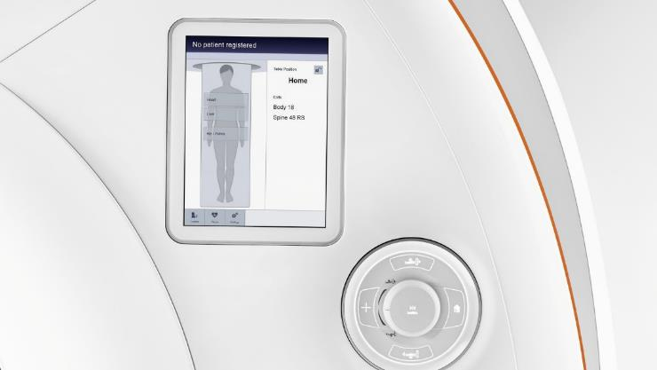
Table of Contents
Updated Functions 3
File I/O 4
Key Points Editing 5
RAFT 6
Principle 7
Usage 8
Problem Encountered 9
Future Direction 14

Slide 17
Annotation Tool
Updated Functions

Slide 18

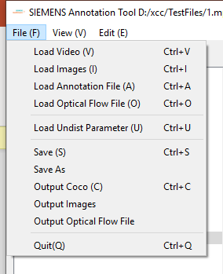
SSME Strategic Initiative
❖ Drive Innovation
Updated Functions
File I/O
Load Optical Flow Result
Output COCO as json file
Output Optical Flow Result
The animation of the dot pulse can be optionally switched off.
Go to Animations > Animations Pane.
Restricted © Siemens Healthcare GmbH, 2018

Slide 19
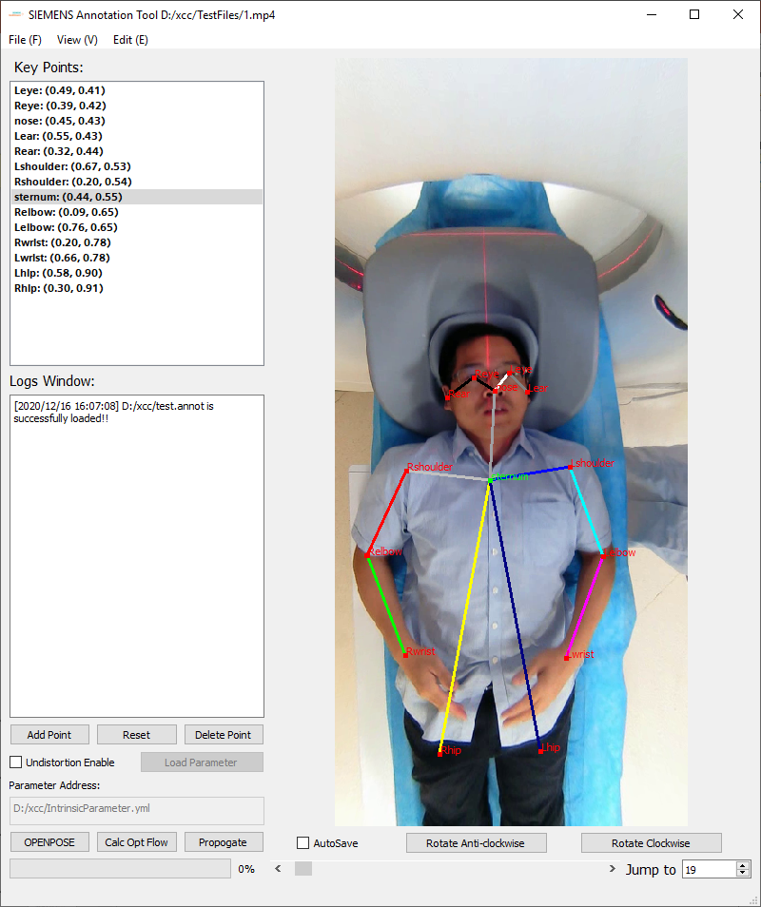
SSME Strategic Initiative
❖ Drive Innovation
Updated Functions
Key Point Editing
Directly operate on image
- left click to select
- hold A and left click to add
- D to delete selected point
- hold ctrl to move point
The animation of the dot pulse can be optionally switched off.
Go to Animations > Animations Pane.
Restricted © Siemens Healthcare GmbH, 2018

Slide 20
Annotation Tool
RAFT

Slide 21
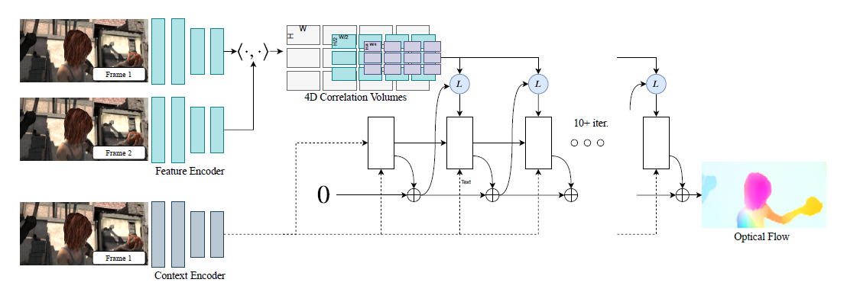
SSME Strategic Initiative
❖ Drive Innovation
RAFT
Principle
1
2
3
The animation of the dot pulse can be optionally switched off.
Go to Animations > Animations Pane.
Restricted © Siemens Healthcare GmbH, 2018

Slide 22
SSME Strategic Initiative
❖ Drive Innovation
RAFT
Usage
OPENPOSE
RAFT Server
RAFT Result
Move KeyPoints
The animation of the dot pulse can be optionally switched off.
Go to Animations > Animations Pane.
Restricted © Siemens Healthcare GmbH, 2018

Slide 23
Annotation Tool
Problem Encountered

Slide 24
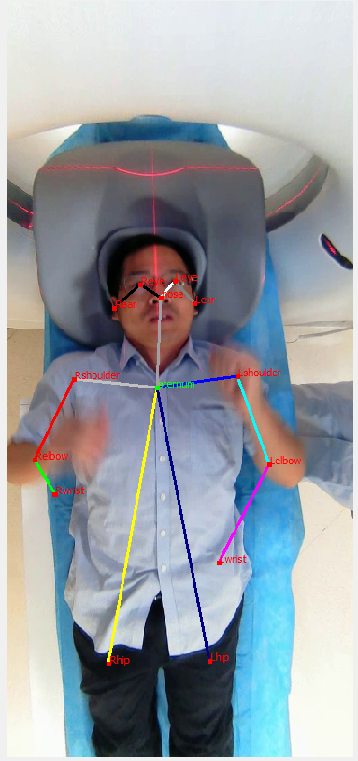
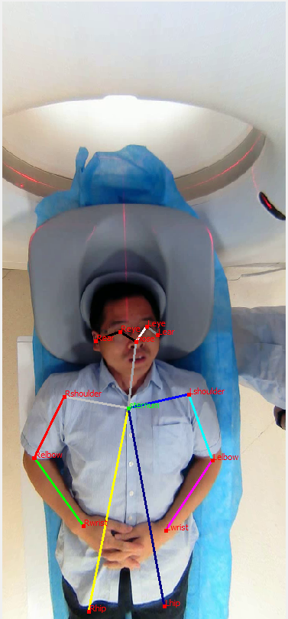
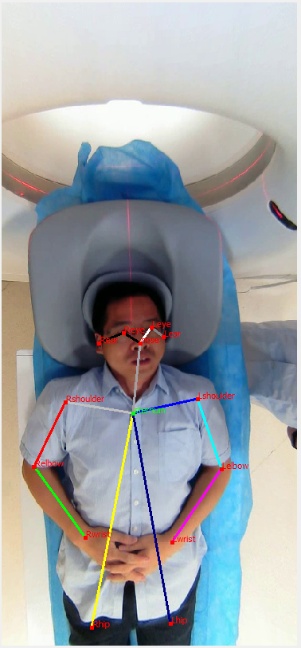
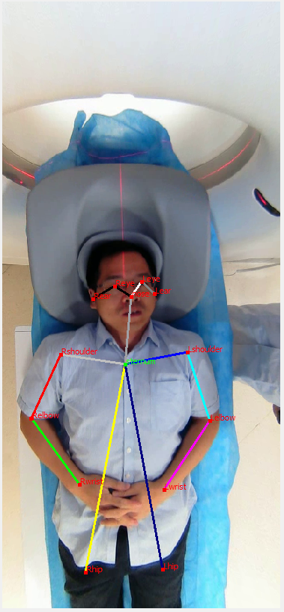
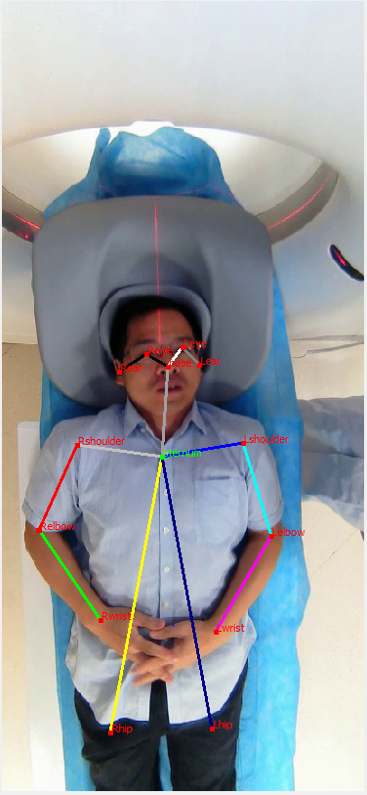
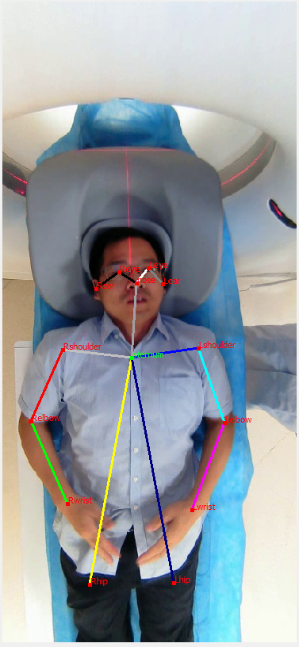
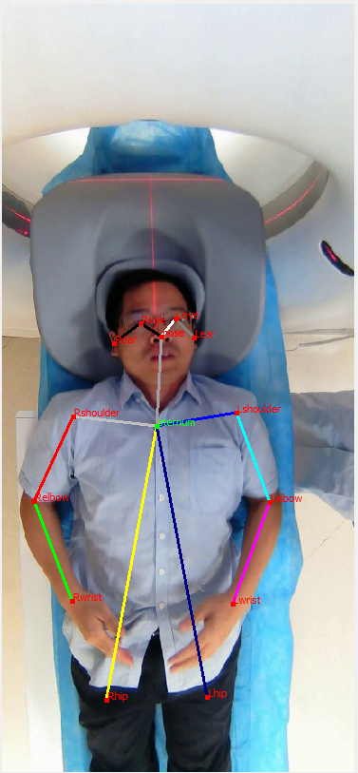
SSME Strategic Initiative
❖ Drive Innovation
Problem Encountered
Inaccuracy in extreme cases
The animation of the dot pulse can be optionally switched off.
Go to Animations > Animations Pane.
Restricted © Siemens Healthcare GmbH, 2018

Slide 25
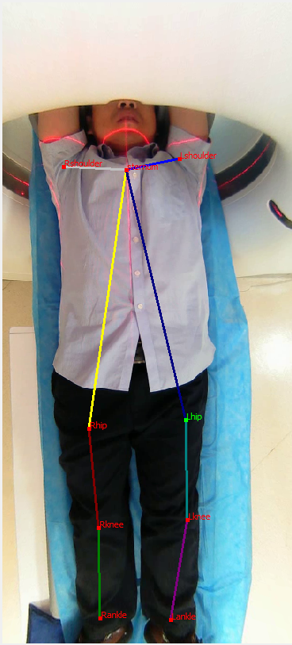
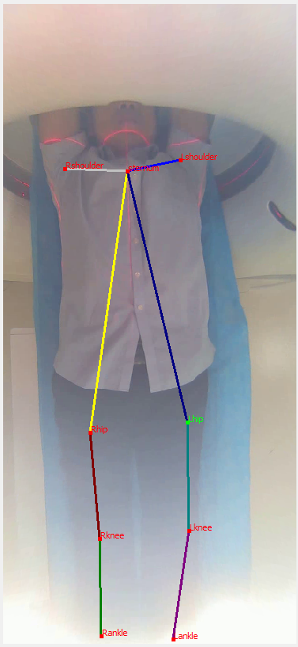
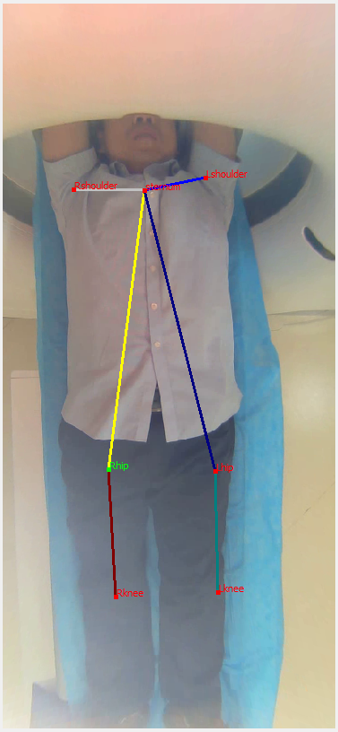
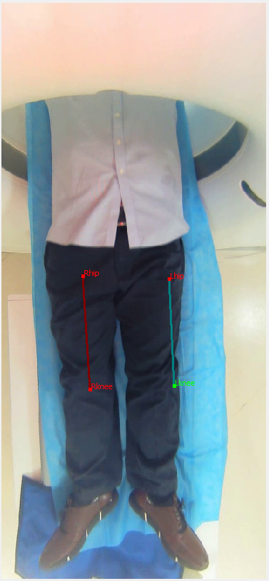
SSME Strategic Initiative
❖ Drive Innovation
Problem Encountered
Inaccuracy in overexposure
The animation of the dot pulse can be optionally switched off.
Go to Animations > Animations Pane.
Restricted © Siemens Healthcare GmbH, 2018

Slide 26
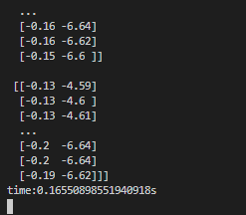
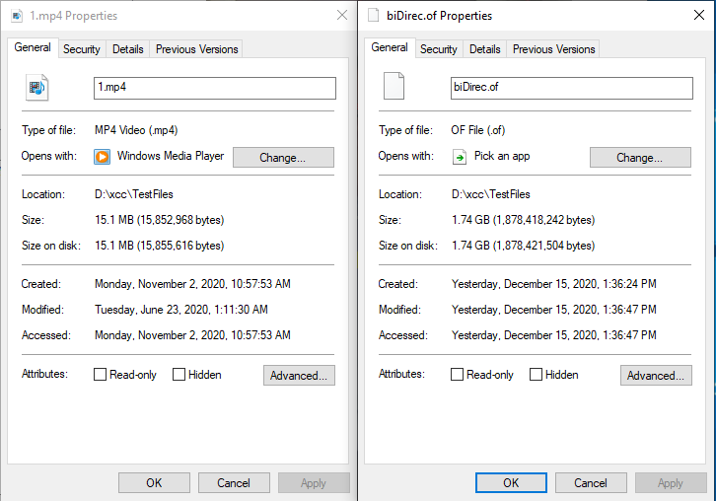
SSME Strategic Initiative
❖ Drive Innovation
Problem Encountered
Result oversize
RAFT processes roughly 6 frames per sec, not feasible for real-time annotating
RAFT result takes 100x more is store to disk without any post-processing.
We have few TB videoclips, not feasible (I/O stream or ffmpeg encode)
The animation of the dot pulse can be optionally switched off.
Go to Animations > Animations Pane.
Restricted © Siemens Healthcare GmbH, 2018

Slide 27
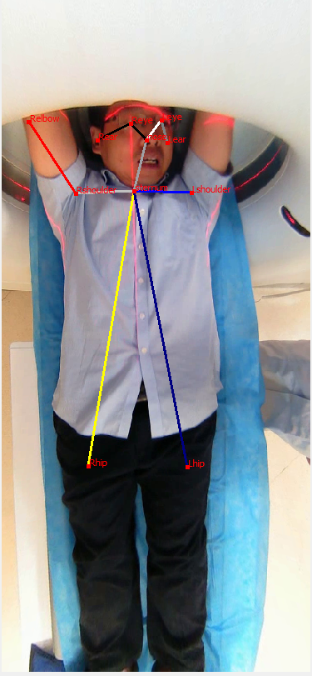
SSME Strategic Initiative
❖ Drive Innovation
Problem Encountered
Block view of CT machine
Loss keypoints due to CT view, need human interaction
The animation of the dot pulse can be optionally switched off.
Go to Animations > Animations Pane.
Restricted © Siemens Healthcare GmbH, 2018

Slide 28
Annotation Tool
Future Direction

Slide 29
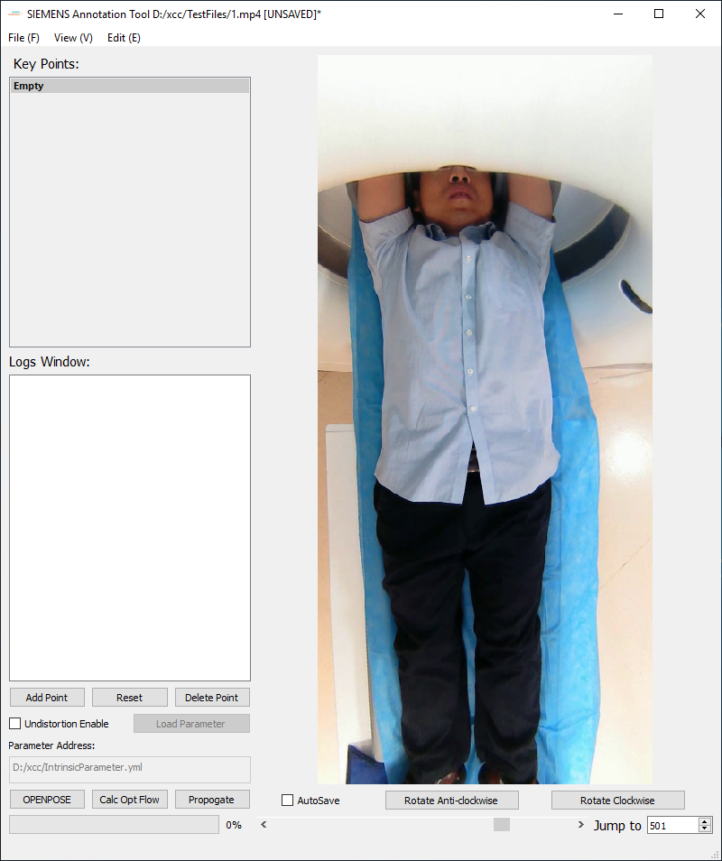
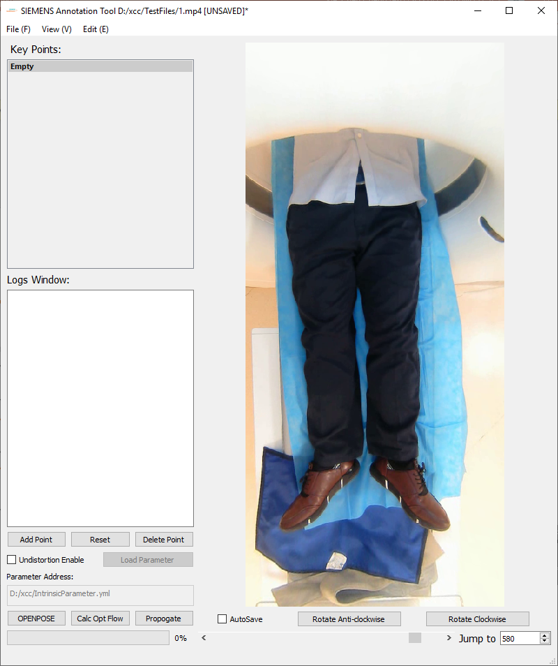
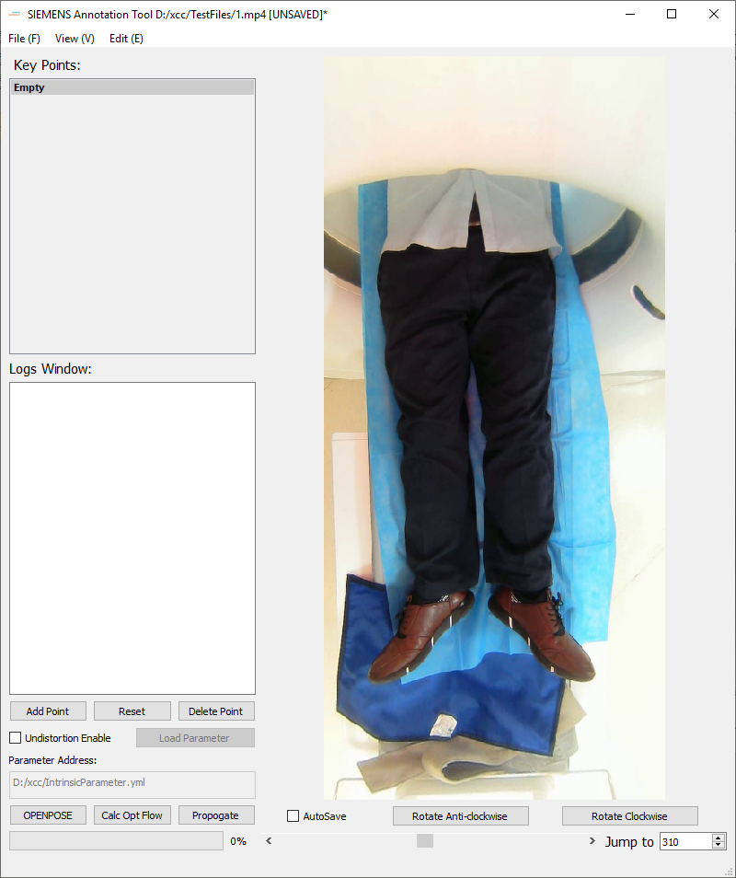
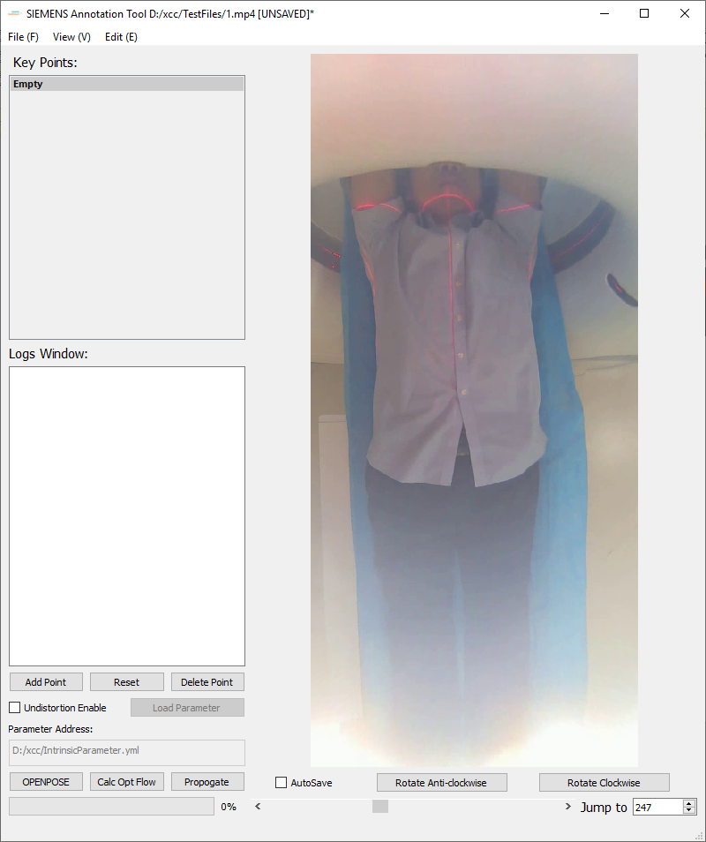
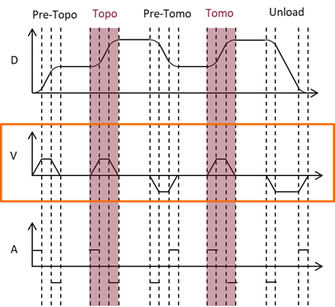
SSME Strategic Initiative
❖ Drive Innovation
Future Direction
Stage indicator
The animation of the dot pulse can be optionally switched off.
Go to Animations > Animations Pane.
Pre-Topo/
Topo
/Pre-Tomo/
Tomo
/Unload
Restricted © Siemens Healthcare GmbH, 2018

Slide 30
SSME Strategic Initiative
❖ Drive Innovation
Future Direction
Bulk operations on multiple key points
Key points lock (un-editable for user defined frames)
The animation of the dot pulse can be optionally switched off.
Go to Animations > Animations Pane.
Restricted © Siemens Healthcare GmbH, 2018

Slide 31
SSME Strategic Initiative
❖ Drive Innovation
UPDATE
The animation of the dot pulse can be optionally switched off.
Go to Animations > Animations Pane.

Slide 32
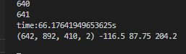
SSME Strategic Initiative
❖ Drive Innovation
Optical Flow Output too large
The output of RAFT might range larger than the valid range of ffmpeg encoding (uint8 0~255)
We’ll store in uint8 first, then if something is wrong, we recalculate part of the frames to get correct movement
min
max
range
The animation of the dot pulse can be optionally switched off.
Go to Animations > Animations Pane.

Slide 33
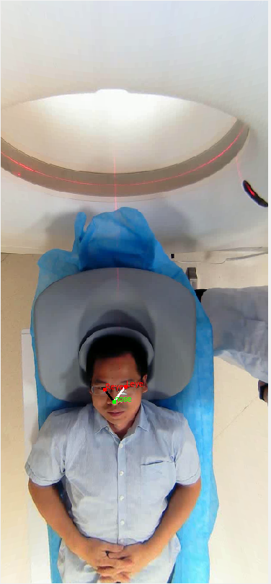
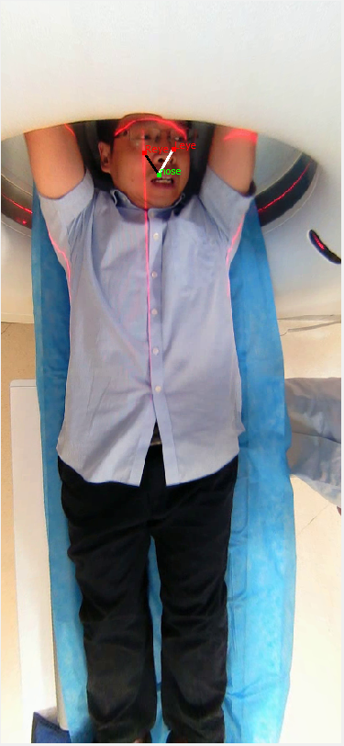
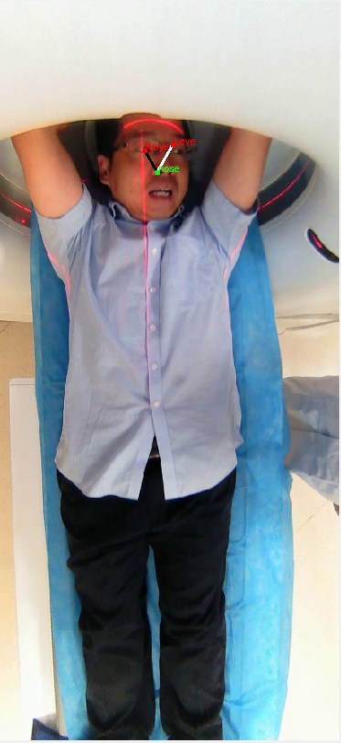

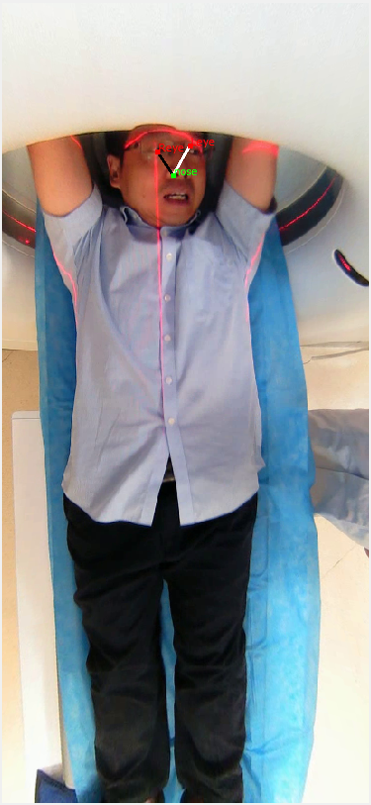
SSME Strategic Initiative
❖ Drive Innovation
Optical Flow precision
The animation of the dot pulse can be optionally switched off.
Go to Animations > Animations Pane.
Starting frame
直接存成int8
读成int8
先存成float16,round(0)后再存成int8
读成int8
先存成float16,round(0)
读成float16
存成float16,不round
读成float16
Ideal way is to store as np.float16, round to integer and saved as int8

Slide 34
SSME Strategic Initiative
❖ Drive Innovation
Dealing with Time and Space Complexity
Try to resize either image frame or the RAFT matrix and upsize back when in use, see if this causes inaccuracy.
The animation of the dot pulse can be optionally switched off.
Go to Animations > Animations Pane.

Slide 35

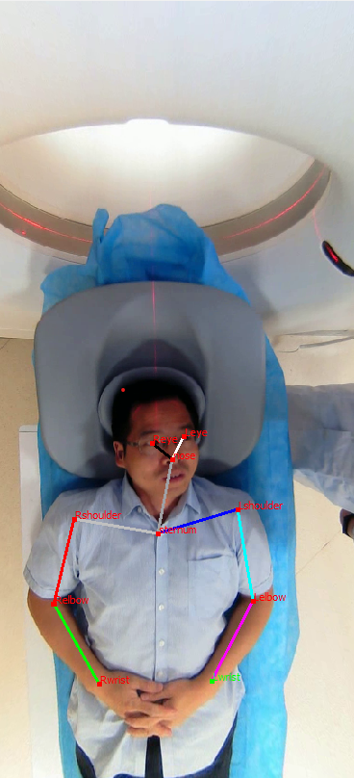


SSME Strategic Initiative
❖ Drive Innovation
RAFT Calculation Time Cost
Conclusion:
resizing on image frame has large impact while resizing on RAFT matrix has little effect, server calculate RAFT matrix in (W/4,H/4) size
The animation of the dot pulse can be optionally switched off.
Go to Animations > Animations Pane.
Calculate RAFT, Then resize to H/4,W/4
Resize frame to H/4,W/4, Then calculate RAFT

Slide 36
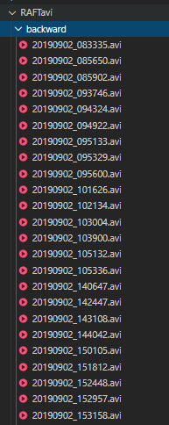
SSME Strategic Initiative
❖ Drive Innovation
Use FFMPEG Encoding to save storage
FFMPEG Fourcc=“FFV1” .avi
The animation of the dot pulse can be optionally switched off.
Go to Animations > Animations Pane.

Slide 37
SSME Strategic Initiative
❖ Drive Innovation
Work Flow Chart
1
Server pre-compute RAFT result matrices, stored in *.avi form
RAFT Server
Client
Video Clips
5
Real time calculation if NULL result (set to NULL for overflow frames under int8 dtype)
RAFT Result
3
Client request RAFT result by video clips’ filename as id/key
2
Client request Openpose KeyPoints for one frame
The animation of the dot pulse can be optionally switched off.
Go to Animations > Animations Pane.
4
Move keypoints according to RAFT results
Openpose Server

Slide 38
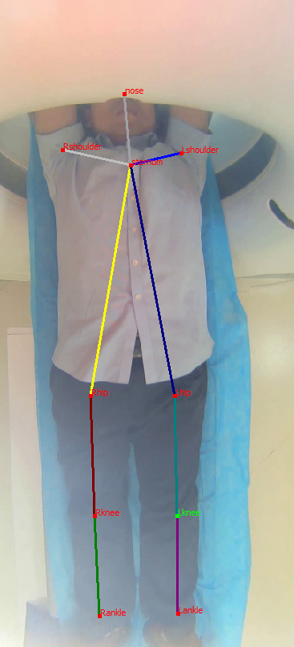
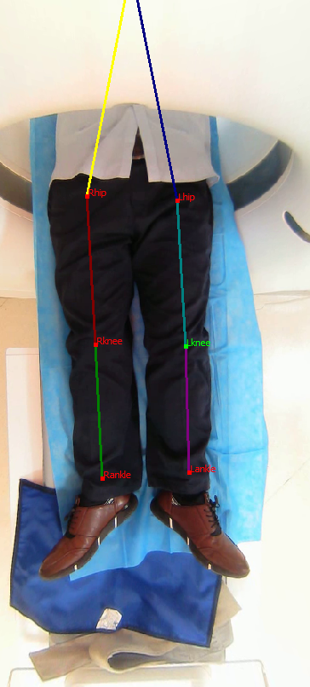
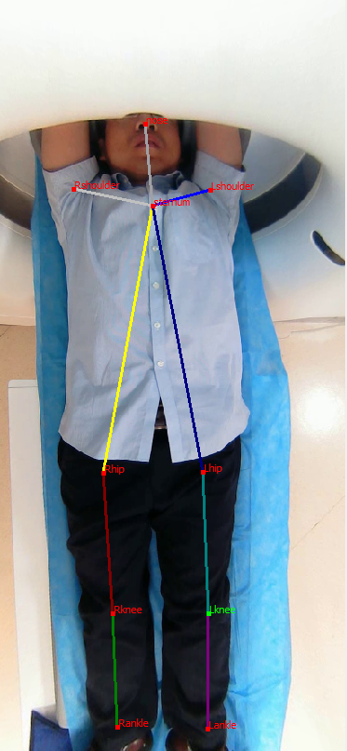
SSME Strategic Initiative
❖ Drive Innovation
Global movements on main body part
Frame 280
Frame 350
Frame 500
The animation of the dot pulse can be optionally switched off.
Go to Animations > Animations Pane.
Before getting out of bound
{nose, sternum, L/R shoulder} not visible
Back in the field

Slide 39
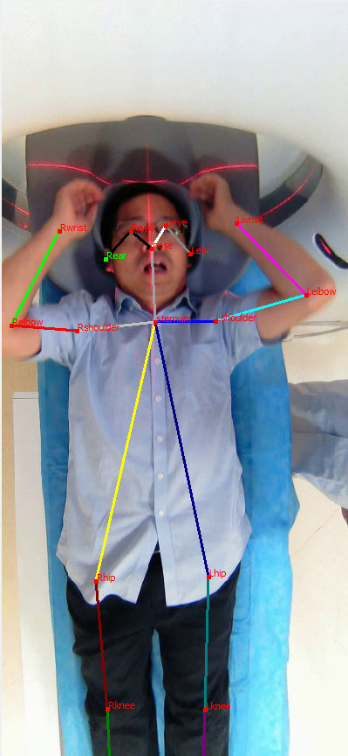
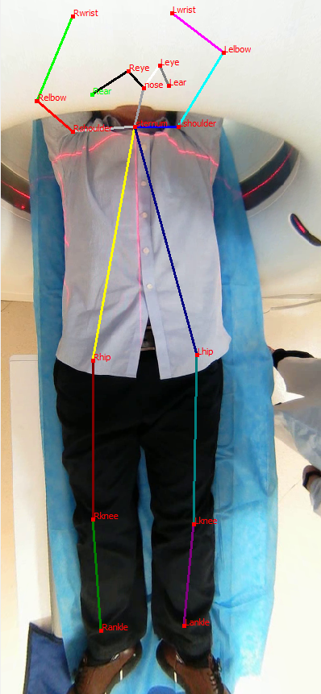
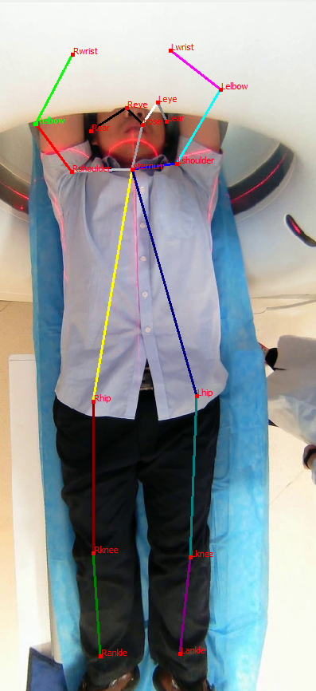
SSME Strategic Initiative
❖ Drive Innovation
Global movements on minor body part
Frame 28
Frame 41
Frame 75
The animation of the dot pulse can be optionally switched off.
Go to Animations > Animations Pane.
Before getting out of bound
Facial/Limbs key points not visible
Back in the field

Slide 40
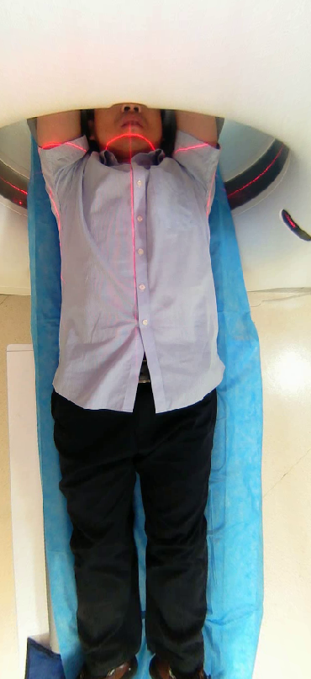
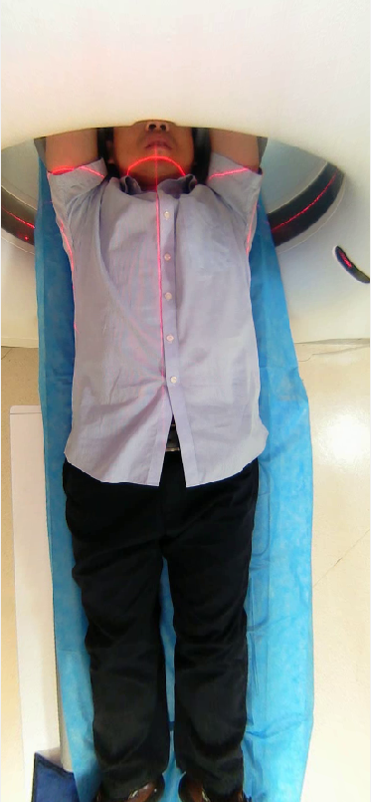
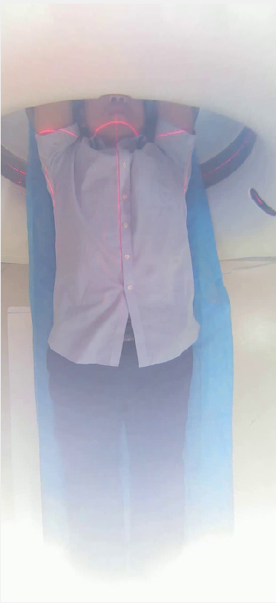
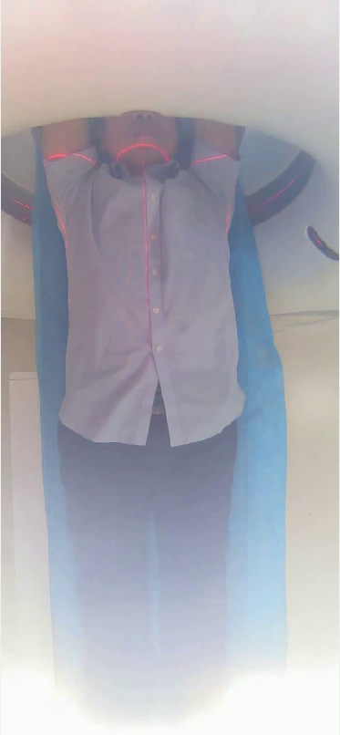

SSME Strategic Initiative
❖ Drive Innovation
Over Exposure
Prior knowledge: when encounter over-exposure, the patient should consider to be static for the first 20~30 frames. Freeze all keypoints movement.
The animation of the dot pulse can be optionally switched off.
Go to Animations > Animations Pane.
Restricted © Siemens Healthcare GmbH, 2018

Slide 41
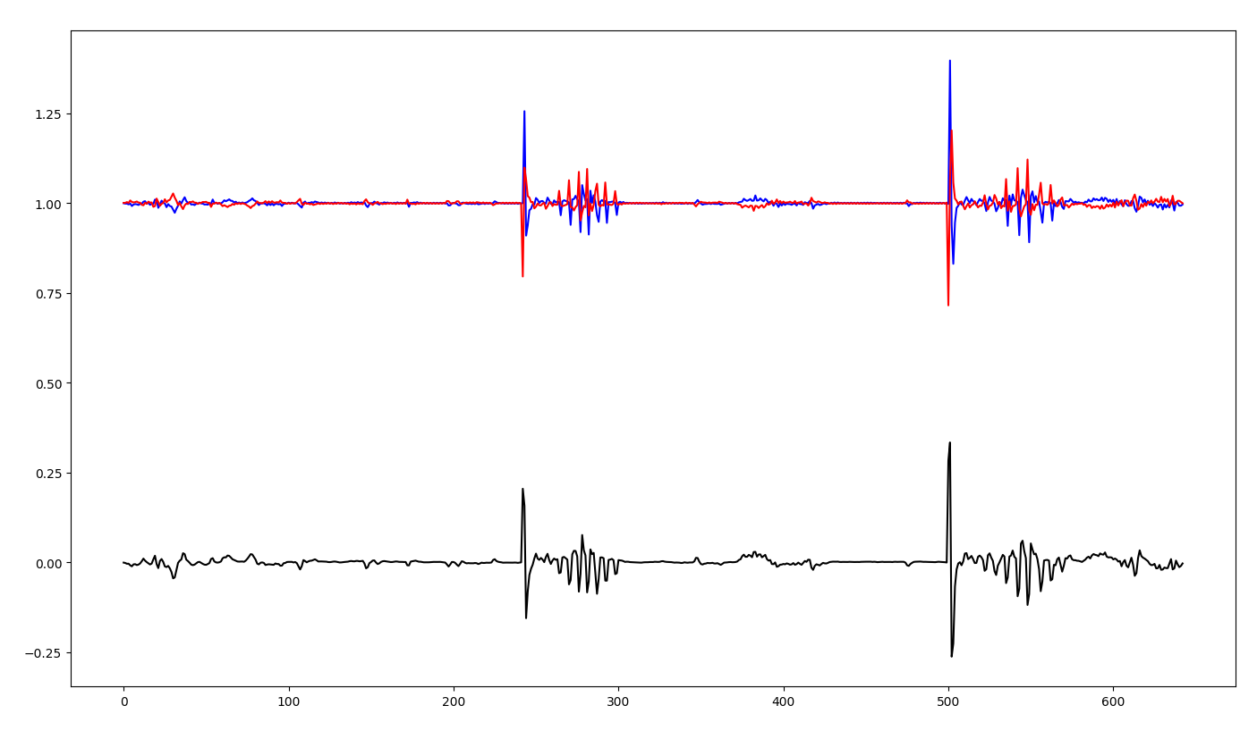
SSME Strategic Initiative
❖ Drive Innovation
Over Exposure
Detection the phase of over exposure
Good indication of phase start
Bad indication of phase end
The animation of the dot pulse can be optionally switched off.
Go to Animations > Animations Pane.

Slide 42
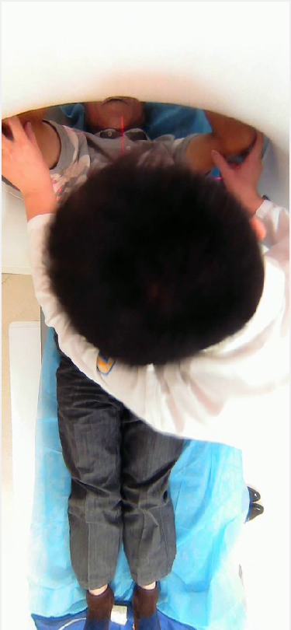
SSME Strategic Initiative
❖ Drive Innovation
Error Frames
How to define Error frame?
Over exposure
Special scenario:
How to deal with Error frame?
Try to skip those frames (maybe some warming sign on those frames)
The animation of the dot pulse can be optionally switched off.
Go to Animations > Animations Pane.

Slide 43
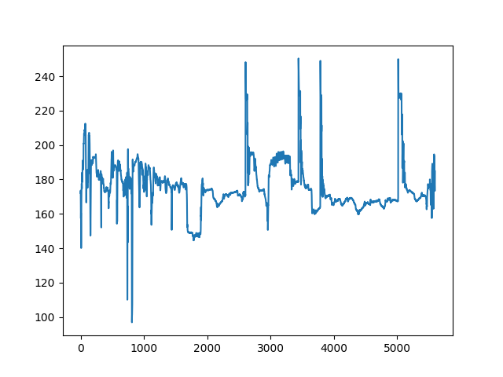
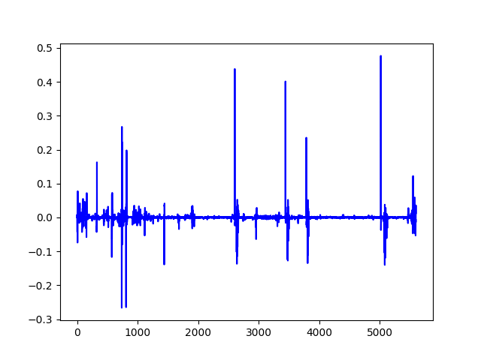
SSME Strategic Initiative
❖ Drive Innovation
Error Frames
Intensity vs frame
How to define Error frame?
(Intensity ratio to prev-1) vs frame
The animation of the dot pulse can be optionally switched off.
Go to Animations > Animations Pane.

Slide 44

SSME Strategic Initiative
❖ Drive Innovation
Intensity chart， 提前算好intensity，存成csv，过曝帧手动标红
下一步添加标红区的增删查改（右键）
Hover显示坐标
(自动分析红区)Semi-auto overexpose check:
变化超过“150”判定为过曝开始， 回归“10”后如果stable判定为恢复正常。 Stable->WinSize(20fs)内不再升高
The animation of the dot pulse can be optionally switched off.
Go to Animations > Animations Pane.

Slide 45
SSME Strategic Initiative
❖ Drive Innovation
定义下半身关键点和胸骨/两胯骨的相对关系，当这些关键点在视野外时，用定义好的相对关系和全局运动向量来计算下一帧的位置
速度过快的帧，用list标出来，双击可直接跳到对应帧，细微调整后重新计算
维护一个global movement的csv
The animation of the dot pulse can be optionally switched off.
Go to Animations > Animations Pane.

